Slide 1
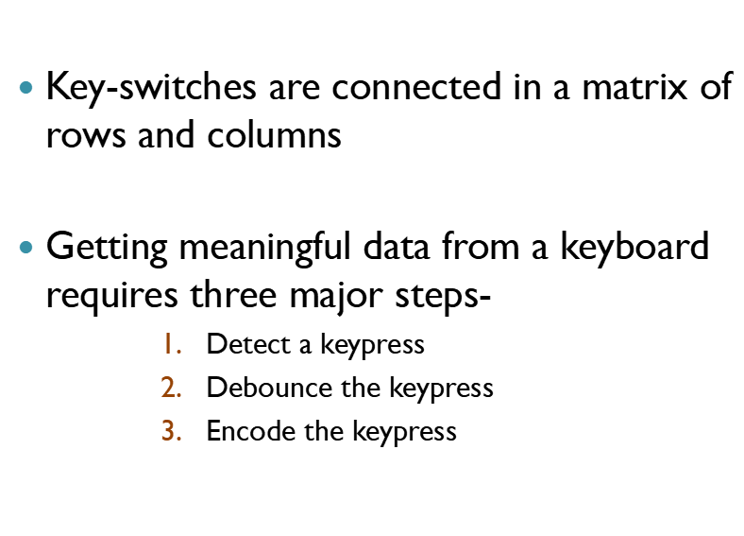
Keyboard Circuit Connections and Interfacing

Slide 2
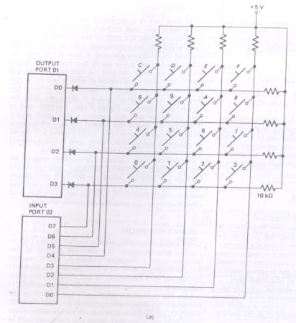
Keyboard Circuit Connections and Interfacing

Slide 3
KYBRD
WAIT 20 ms
DEBOUNCE
KEY FOUND?
NO
ZERO TO ALL ROWS
READ COLUMNS
YES
READ COLUMNS
CONVERT TO HEX
KEY
PRESSED?
NO
NO
ALL KEYS OPEN?
RETURN
YES
ENCODE
OUTPUT ZERO TO ONE ROW
YES
READ COLUMNS
READ COLUMNS
DETECT
NO
KEY
PRESSED?
YES

Slide 4
Interfacing to Alphanumeric Displays
CRT - Large amount of data
LED and LCD - small amount of data
LCD – low power, portable device
LED formats
  18 Segment display - numbers, entire alphabet
  5 by 7 dot matrix-numbers, entire alphabet
  7 Segment displays –numbers, Hexadecimal letters
      least expensive, most commonly used, easiest to interface

Slide 5
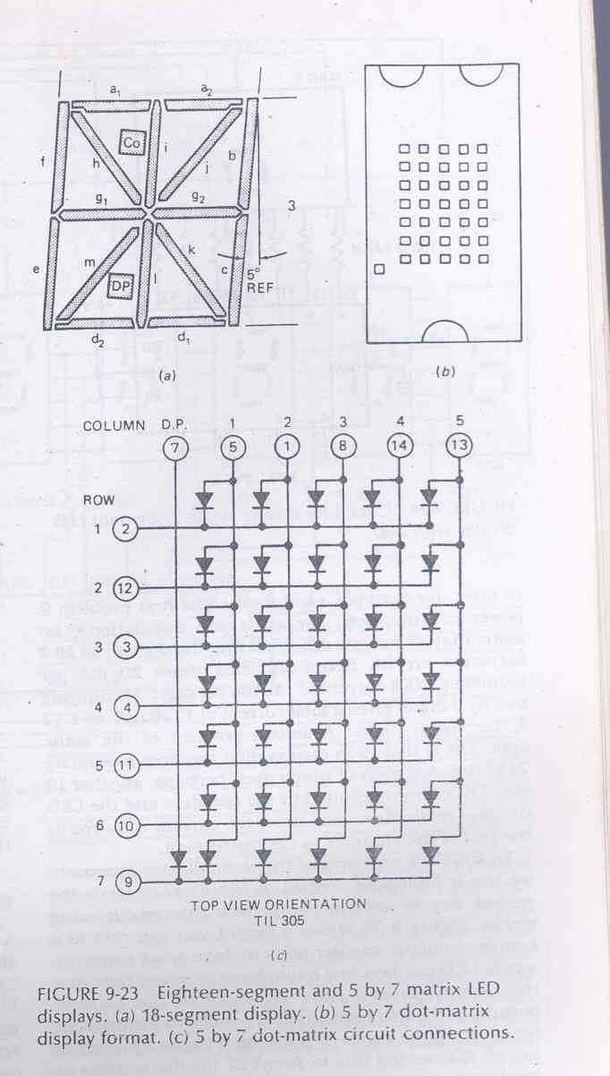

Slide 6
Directly Driving LED displays
Segment is turned on by applying a logic low to it.
7447 converts a BCD code applied to its input to the pattern of lows required to display.
Circuit connection is referred to as a Static display (continuous power consumption)- because current is being passed through the display all the times.
Each segment requires a current of between 5 – 30 mA to light.

Slide 7
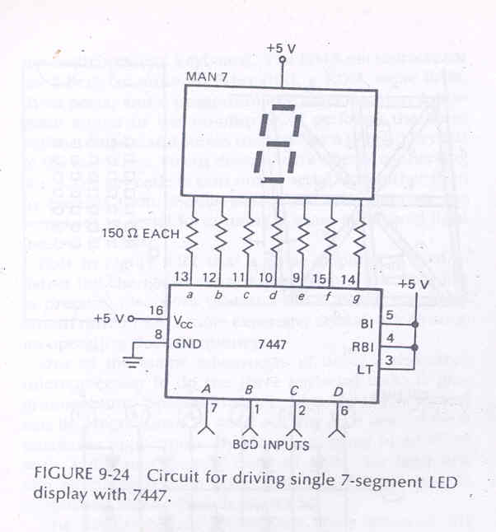

Slide 8
Mathematical problem:
Each segment consume a current of 20 mA. The voltage drop across the LED when it is about 1.5 V. The output low voltage for the 7447 is maximum of 0.4 V at 40 mA. What is the value of current limiting register? What amount of power will be consumed?
Ans: ??

Slide 9
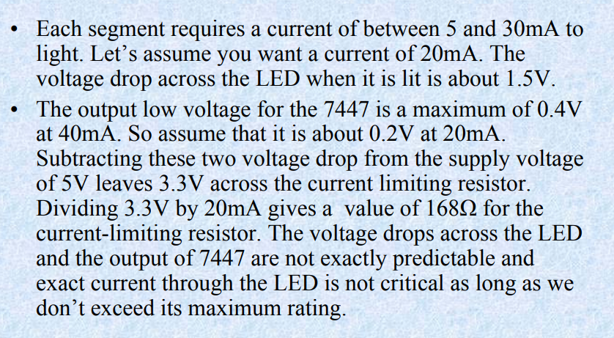
Solution

Slide 10
Problems
Power consumption
    Worse-case
    all digits are displaying the digit 8(All 7 segments are lit)
Each Display digit requires a separate 7447 decoder
    Each of which uses, another 13mA
    What is the Solution??
    -- Multiplex method

Slide 11
Software Multiplexed LED displays
Circuit has only one 7447 and the segment outputs of the 7447 are bused in parallel to the segment inputs of all the digits
Trick of multiplexing – only one display digit is turned on at a time
PNP transistor acts as an on/off switch for the digit
BCD code for digit 1 is output from port B to 7447
Decoder outputs the corresponding 7 segment code on the segment bus line.
Transistor connected to digit 1 is turned on by outputting a low to the appropriate bit of port A.
After 1 or 2 ms digit 1 is turned off & same process is repeated for digit 2 and so on
Refresh rate is fast enough that, to ones eye, the digits will each appear to be lit all the time
Refresh rate of 40 to 200 times a second are acceptable

Slide 12
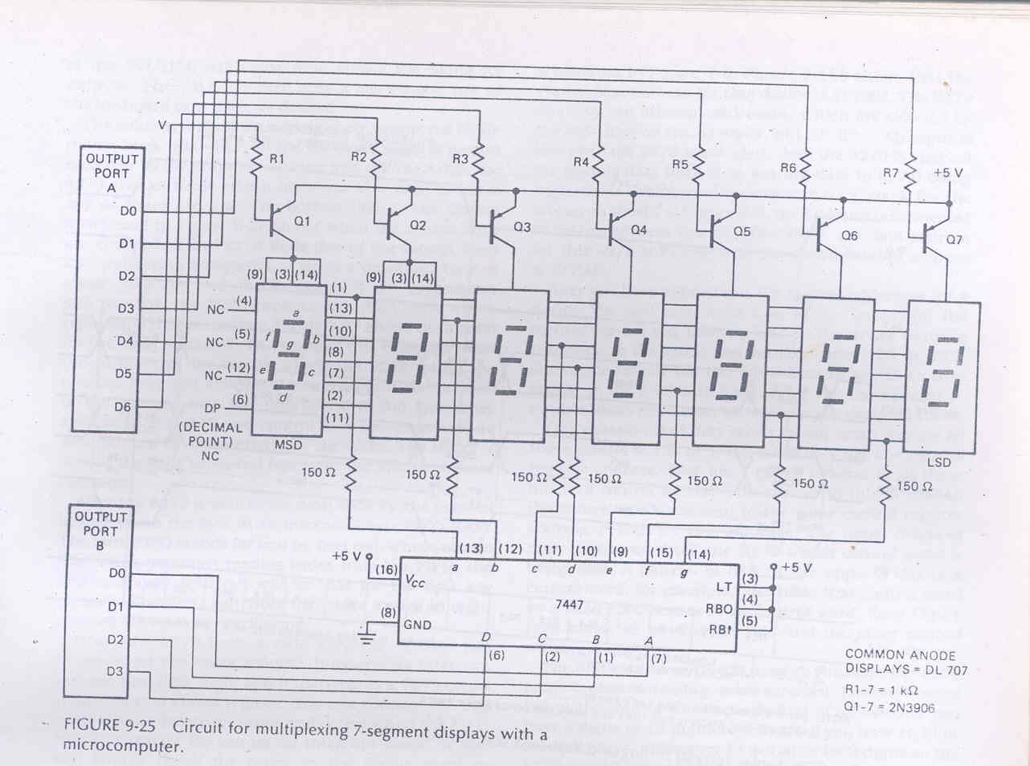

Slide 13
Advantages
Less Power consumption
  Only 1 digit is lit at a time.
Only one 7447 is required

